Slide 1
Udacity Connect Session
June 9, 2018
Recurrent Neural Networks

Slide 2
Welcome back!

Slide 3



Slide 4
Morning Schedule
10:00 - 10:30 | Housekeeping, Project Template
10:30 - 11:00 | Recurrent Neural Networks
11:00 - 12:00 | Work on Capstone Project/Proposal
© 2016 Udacity. All rights reserved.

Slide 5
Capstone Project Report
Proposal
FInal Report
Domain Background
Problem Statement
Datasets
Solution
Benchmark
Metrics
Project Design
Introduction/Background
Analysis
Methodology
Results
Conclusions

Slide 6
Sequence Analysis with Deep Learning
What’s different?
What is a recurrent unit?
Architectures for recurrent networks
Examples

Slide 7
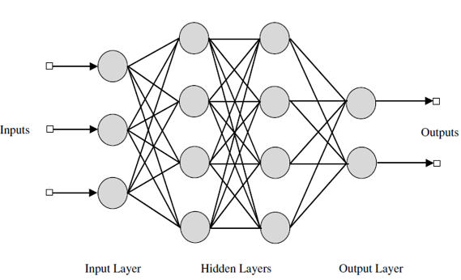
Network of Perceptrons
Input
Bias
Output
Hidden
1
1
1

Slide 8
Structure of a Perceptron
http://neuralnetworksanddeeplearning.com/
x₁
w₁
x₁
w₁
W^{T}x
a(W^{T}x)
x₂
w₂
x₂
w₂
w₃
w₃
x₃
x₃

Slide 9
Recurrent Unit
W^{T}X_{t}
a(W^{T}X_{t})
𝜎(..)
X_{t}
W

Slide 10
Recurrent unit -- unfolded
y₁
y₂
y_{t}
y_{n}
a₁
a_{n-1}
a₀
a₁
a_{t-1}
a_{n-1}
X₁
X₂
X_{t}
X_{n}

Slide 11
GRU - Gated Recurrent Unit
keras.layers.GRU
a_{t-1}
c_{t}
a_{t}
c’_{t}
𝜎_{r}
tanh
𝜎_{u}
X_{t}

Slide 12
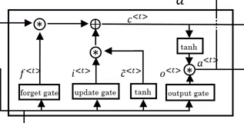
Long Short Term Memory (LSTM)
keras.layers.LSTM
c_{t-1}
c_{t}
a_{t-1}
a_{t}
X_{t}

Slide 13
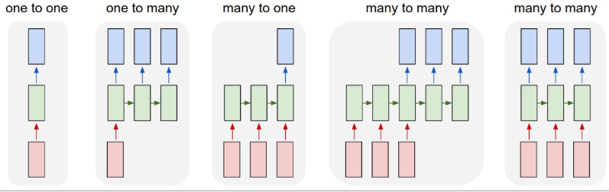
Common Architectures
http://karpathy.github.io/2015/05/21/rnn-effectiveness/

Slide 14
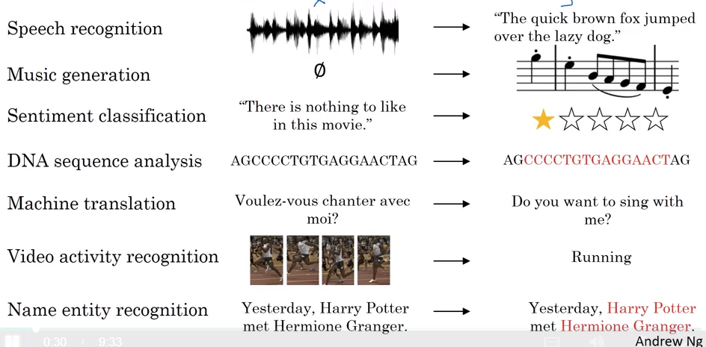
Applications
https://www.coursera.org/learn/nlp-sequence-models/lecture/BO8PS/different-types-of-rnns

Slide 15
Other Topics
Bidirectional RNNs (keras.layers.Bidirectional)
Deep RNNs
Embeddings

Slide 16
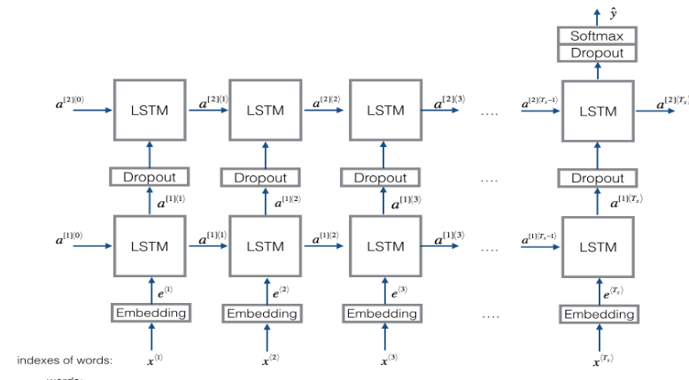

Slide 17
LSTM Model
I = Input(input_shape)
embedding_layer = Embedding(I.shape[1], 50)(I)
X = LSTM(128, return_sequences=True)(embedding_layer)
X = Dropout(0.5)(X)
X = LSTM(128)(X)
X = Dropout(0.5)(X)
X = Dense(5)(X)
X = Activation("softmax")(X)
model = Model(inputs=I, outputs=X)

Slide 18
Another architecture
X_input = Input(shape = input_shape)
X = Conv1D(196, 15, strides=4)(X_input) # CONV1D
X = BatchNormalization()(X)
X = Activation("relu")(X)
X = Dropout(0.5)(X)
X = GRU(units = 128, return_sequences = True)(X)
X = Dropout(0.8)(X)
X = TimeDistributed(Dense(1, activation = "sigmoid"))(X)
model = Model(inputs = X_input, outputs = X)

Slide 19
Lunch Break

Slide 20
Afternoon Session
1:00 - 2:50 | Work on Capstone Project
2:50 - 3:00 | Recap, Lookahead and Feedback
3:00 - 5:00 | Work on Projects (Proposal, Project)
© 2016 Udacity. All rights reserved.

Slide 21
Work on projects

Slide 22
Capstone Project Presentations
Background/Problem Statement
Exploratory Data Analysis (should include one figure)
Preprocessing
Metrics and Benchmarks
Methodology and Results

Slide 23
Prep for next session
Work on Capstone project due 6/16/18
Capstone project presentation in-class 6/16/18

Slide 24
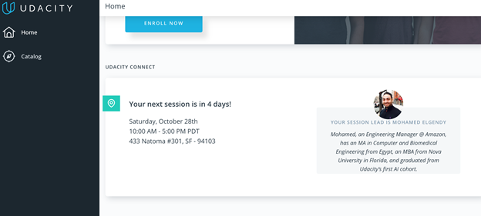
We really need your Feedback!
© 2016 Udacity. All rights reserved.

